Slide 1


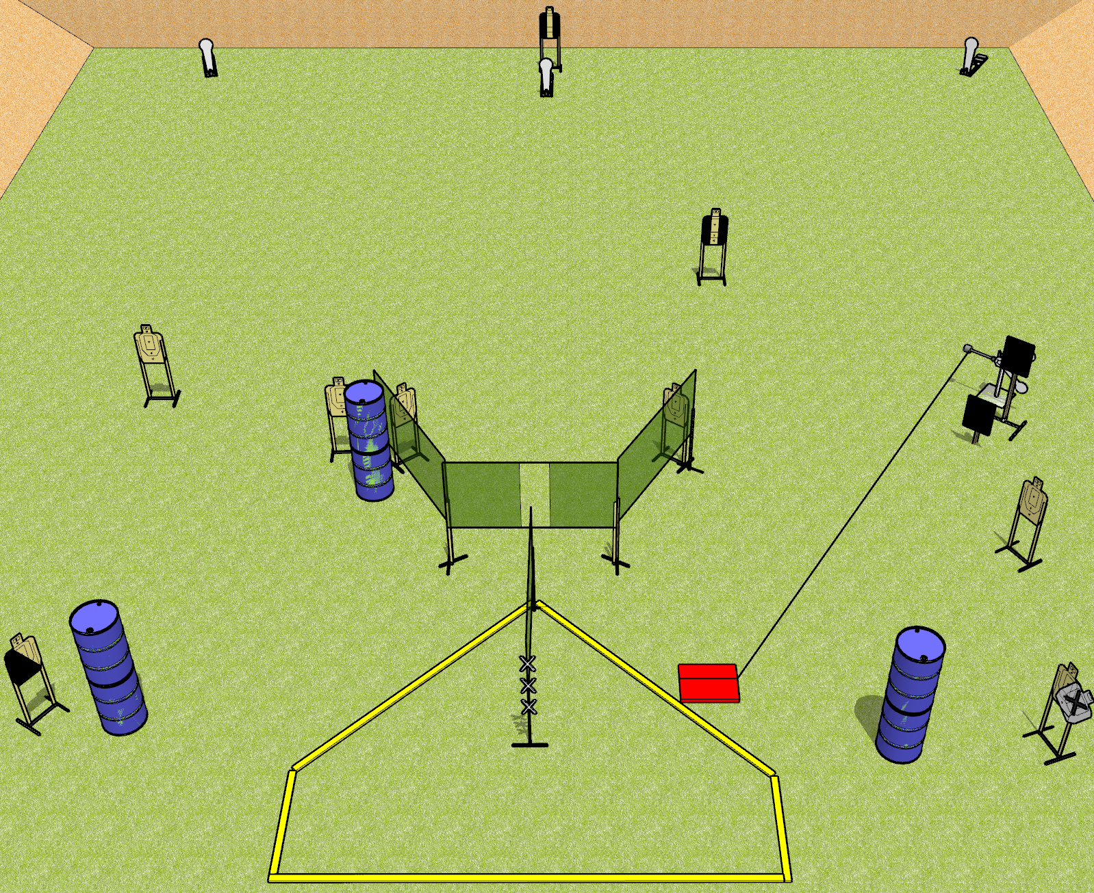
 | Dothan Gun Club – USPSA Match Hit the Plate Course Designer : Drew Coleman
Round Count 23 rounds 9 USPSA targets 3 colt poppers, 2 falling plates
Equipment List 8 wall feet Red stitch target Stomp box 2 18x24 plates + stands 2 tuxedos, 1 diagonal

Slide 2
Hit the Plate
Written Stage Briefing
Hit the Plate is a 23 round, 115 point, Comstock field course. There are 9 USPSA targets, 3 colt poppers, and 2 falling plates. The best 2 hits on paper will score, and steel must fall to score. The start signal is audible.
The swinging plates are activated by the stomp box. Please check the activator prior to walkthrough and set the activator the same way every time.
Handgun start position is hands touching marks on wall. Handgun is loaded and holstered.
PCC start position is muzzle touching any mark on wall. Loaded carbine is held with both hands, stock on belt, safety on.
On start signal, engage targets as they become available from within the shooting area.

